Slide 1
Deep Neural Networks
UNIT 3

Slide 2
Outline
Deep Neural Networks:
Introduction
Necessity of deep neural networks (DNN),
Auto encoder and its types.

Slide 3

Driverless Cars

Slide 4








Slide 5
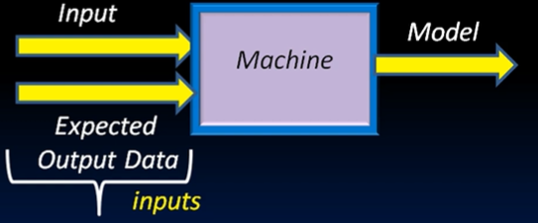
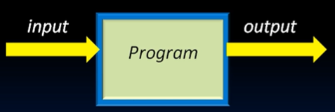
Traditional Programming Traditional Machine Learning

Slide 6
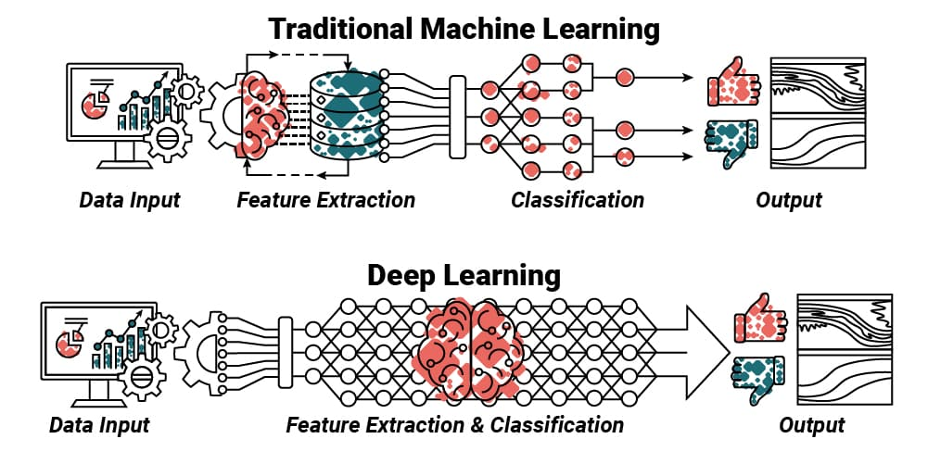

Slide 7
Handling Complex Data
Machine Learning: Traditional machine learning algorithms (like decision trees, support vector machines, etc.) struggle with complex, high-dimensional data such as images, videos, and raw audio.
Deep Learning: Deep learning, using neural networks with many layers, excels in understanding and extracting features from such complex data types.
  For example, convolutional neural networks (CNNs) are highly effective for image recognition.

Slide 8
Feature Engineering
Machine Learning: Most machine learning algorithms require manual feature engineering. This means human experts have to decide which features to extract from raw data.
Deep Learning: Deep learning automates feature extraction. Neural networks, especially deep ones, learn to extract high-level features on their own, removing the need for human involvement in feature design.

Slide 9
Performance on Large Datasets
Machine Learning: Traditional machine learning models plateau in performance as datasets grow in size. They might require a lot of pre-processing and can only learn up to a certain complexity.
Deep Learning: Deep learning thrives on large datasets. With sufficient data, deep learning models can improve their accuracy and generalization by capturing intricate patterns that traditional algorithms might miss.

Slide 10
Unstructured Data
Machine Learning: Machine learning is more effective when applied to structured data like spreadsheets or databases where relationships between data points are predefined.
Deep Learning: Deep learning is well-suited for unstructured data (e.g., raw text, images, and speech).
  For example, Recurrent Neural Networks (RNNs) and Long Short-Term Memory (LSTM) networks are used for sequential data like time series, speech, and text.

Slide 11
Scalability
Machine Learning: As complexity increases, traditional machine learning algorithms struggle to scale. Complex tasks require significant human oversight and manual adjustments.
Deep Learning: Deep learning models can scale with both the amount of data and computational resources. With advances in hardware (GPUs, TPUs) and parallel processing, deep learning models can handle massive datasets and complex tasks without a proportional increase in human effort.

Slide 12
Learning Representations
Machine Learning: In traditional machine learning, the quality of the model is heavily dependent on how good the feature selection is.
Deep Learning: Deep learning models excel at learning complex, hierarchical representations of data. In image recognition, for example, lower layers might recognize edges, while higher layers recognize objects like faces or animals.

Slide 13
Transfer Learning
Machine Learning: Most machine learning models are built from scratch for each specific task, and transferring knowledge from one model to another is not common.
Deep Learning: Transfer learning allows deep learning models pre-trained on one task (e.g., ImageNet classification) to be fine-tuned for other tasks with minimal data and computation. This capability has made deep learning adaptable and scalable across various fields.

